Slide 1

Probability
Mathematical measure of chance

Slide 2
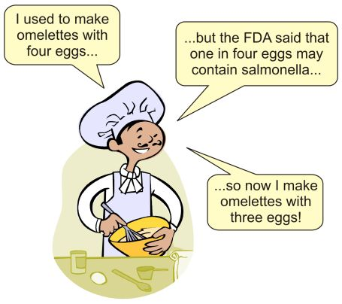
Note: The gender ratio for the entire world population is 101 males to 100 females.

Slide 3

Learning Objectives
Probability
Conditional Probability

Slide 4
Types of Experiment
Deterministic :
Result of an experiment is unique or certain.
Probabilistic :
Result of the experiment is not unique or uncertain.

Slide 5
Various terms in defining probability
Random Experiment or Trail: Experiment conducted any number of times under identical conditions and the result is not certain.
Events: Outcomes of a random experiment.
Sample space: Set of all possible outcomes.
Equally Likely Equal chance of happening.
E.g. A die is thrown is a trial, getting a number 1 or 2 or 3 or 4 or 5 or 6 is an event and {1,2,3,4,5,6} is the sample space.

Slide 6
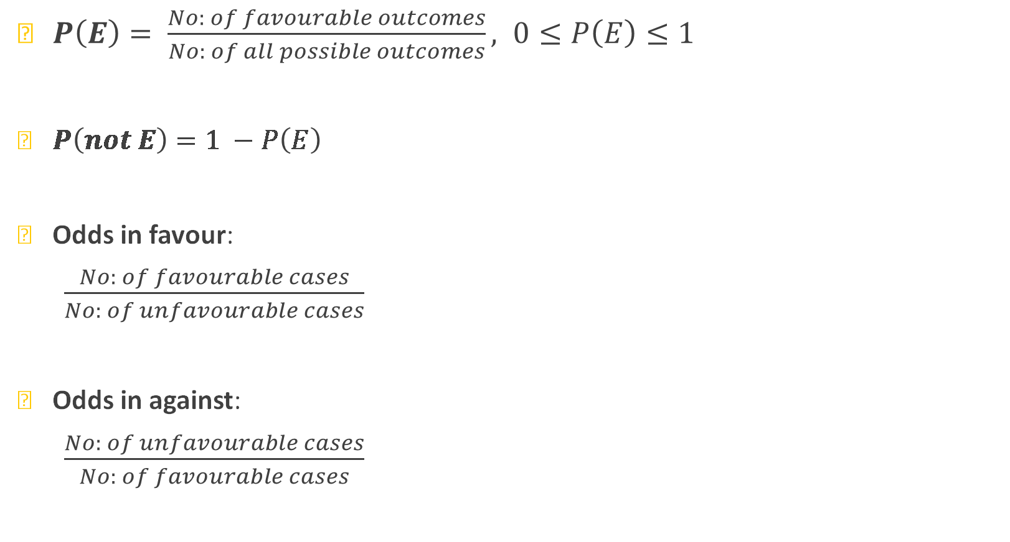
Definitions of Probability
$P\left(E\right)= \frac{No: of favourable outcomes}{No: of all possible outcomes}, 0≤P\left(E\right)≤1$
$P\left(not E\right)=1 −P\left(E\right)$
Odds in favour:
$\frac{No: of favourable cases}{No: of unfavourable cases}$
Odds in against:
$\frac{No: of unfavourable cases}{No: of favourable cases}$

Slide 7
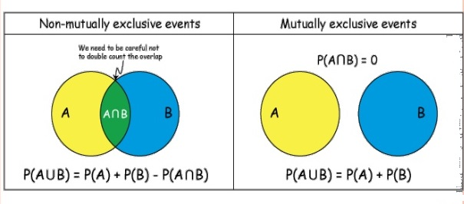
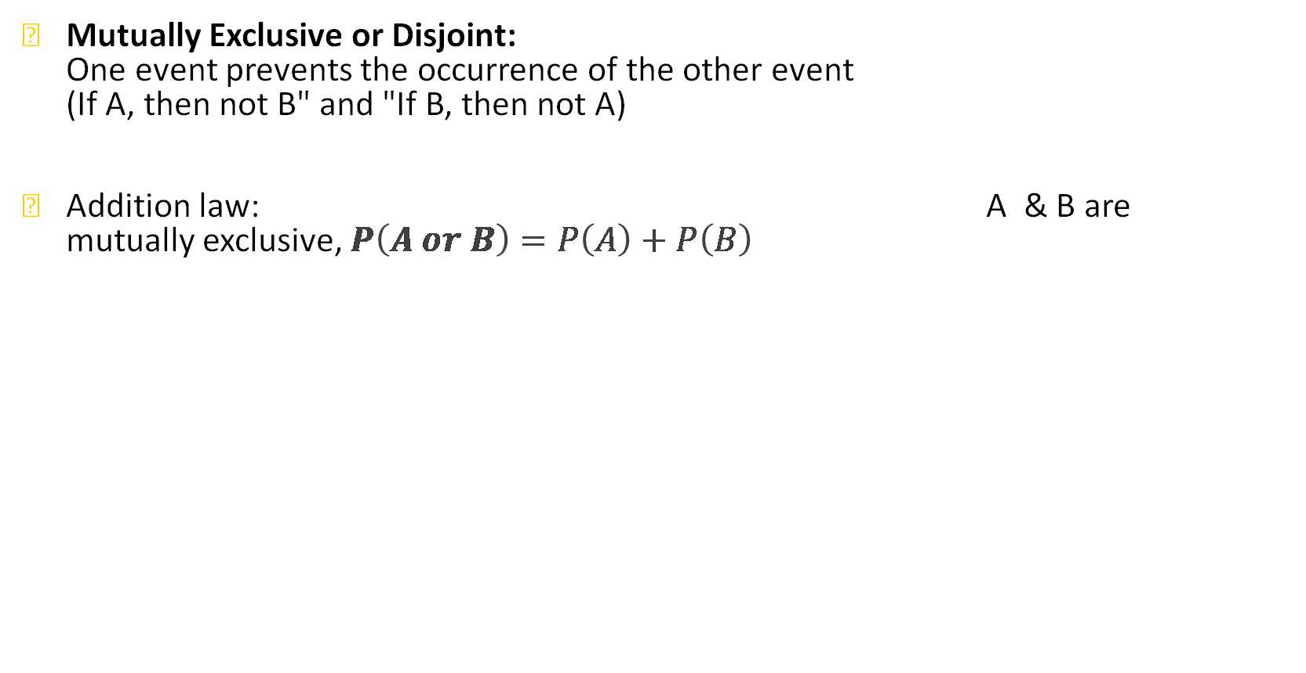
Various terms in defining probability
Mutually Exclusive or Disjoint: One event prevents the occurrence of the other event (If A, then not B" and "If B, then not A)
Addition law: A & B are mutually exclusive, $P\left(A or B\right)=P\left(A\right)+P\left(B\right)$

Slide 8
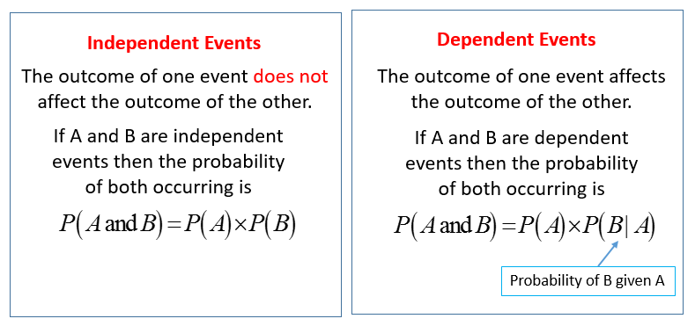

Various terms in defining probability
Independent Events: Occurrence of one event does not affect the probability of the other event.
Multiplication law: A & B are independent, $P\left(A and B\right)=P(A)×P\left(B\right)$

Slide 9
Types of questions
Questions based on:
Coins
Dice
Cards
Balls/Urns
Chess board
Arrangements, Selections
Generic types

Slide 10
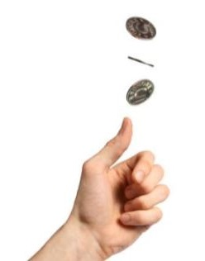
Example 1 Questions on Coins
Three coins are tossed, probability of getting
at least 2 heads
at most 2 heads

Slide 11


Example 2 Questions on Dice
Two dice are rolled, probability of getting the sum a prime number?
A. $\frac{4}{9}$ B. $\frac{1}{3}$ C. $\frac{11}{36}$ D. $\frac{5}{12}$

Slide 12
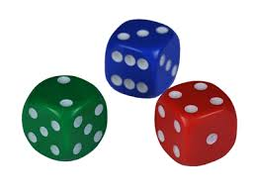

Example 3 Questions on Dice
Three dice are rolled, probability of getting the sum 11?
A. $\frac{21}{216}$ B. $\frac{18}{216}$ C. $\frac{1}{8}$ D. $\frac{1}{36}$

Slide 13
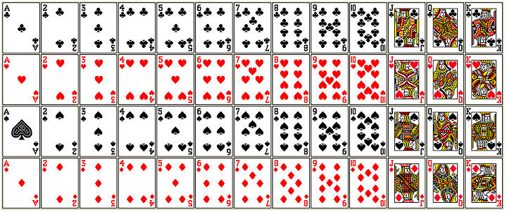

Example 4 Questions on Cards
If you pull 2 cards out of a deck, what is the probability that both are hearts?
A. $\frac{1}{17}$ B. $\frac{1}{16}$ C. $\frac{1}{15}$ D. $\frac{1}{4}$

Slide 14
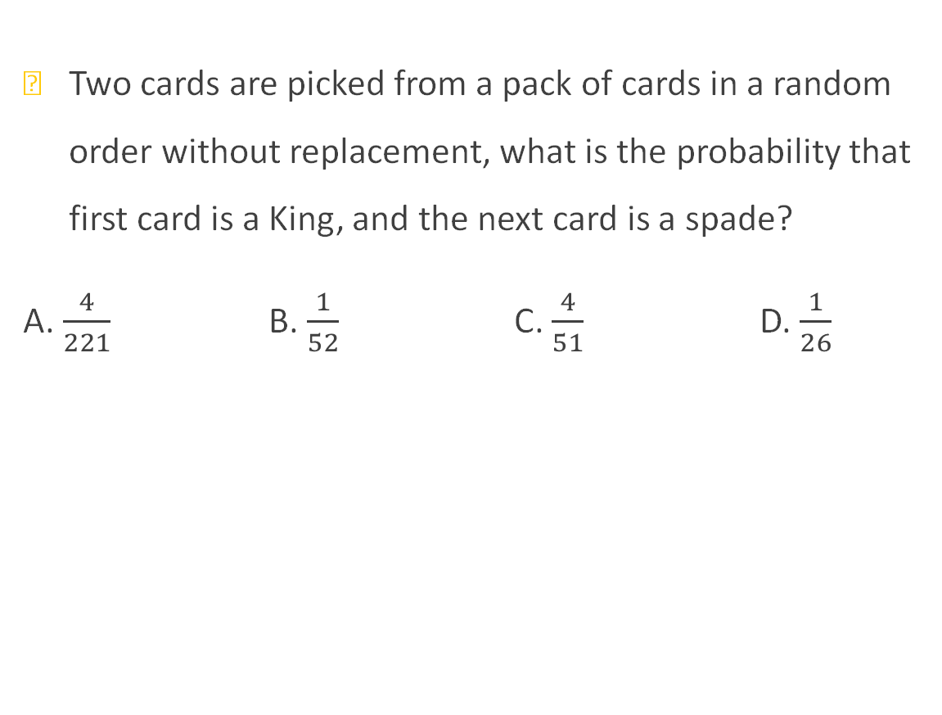
Example 5 Questions on Cards
Two cards are picked from a pack of cards in a random order without replacement, what is the probability that first card is a King, and the next card is a spade?
A. $\frac{4}{221}$ B. $\frac{1}{52}$ C. $\frac{4}{51}$ D. $\frac{1}{26}$

Slide 15


Example 6
A bag contains 3 white balls and 2 black balls. Another bag contains 2 white and 4 black balls. A bag and a ball are picked random. The probability that the ball will be white is?
A. $\frac{7}{11}$ B. $\frac{7}{30}$ C. $\frac{7}{15}$ D. $\frac{5}{11}$

Slide 16
Example 7 Questions on Balls/Urns
There are three similar boxes, containing
I. 6 black and 4 white balls.
II. 3 black and 7 white balls.
III. 5 black and 5 white balls. If you choose, one of the three boxes at random and from that particular box picks up a ball at random, and found that to be black, what is the probability that the ball picked up from the second box?

Slide 17

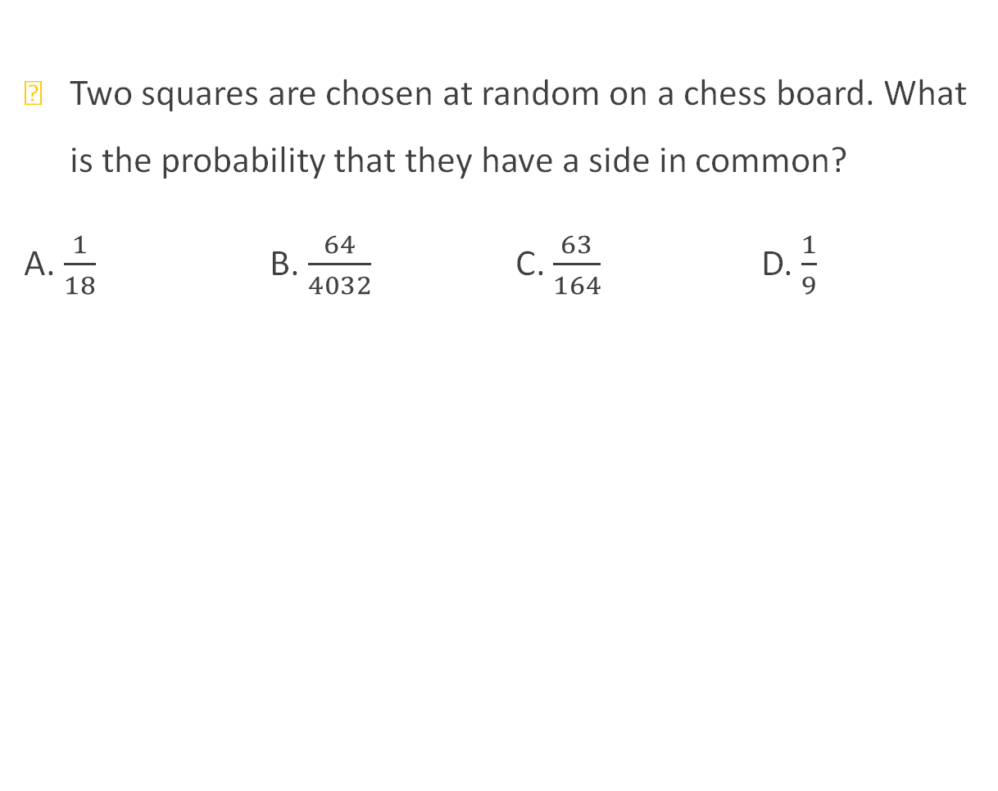
Example 8 Questions on Chess board
Two squares are chosen at random on a chess board. What is the probability that they have a side in common?
A. $\frac{1}{18}$ B. $\frac{64}{4032}$ C. $\frac{63}{164}$ D. $\frac{1}{9}$

Slide 18

Example 9 Questions on arrangements
Eight horses are entered in a race. You randomly predict a particular order for the horses to complete the race. What is the probability that your prediction is correct?
A. $\frac{1}{8}$ B. $\frac{1}{8!}$ C. $\frac{8}{8!}$ D. None of these

Slide 19

Example 10 Questions on arrangements
Four different objects 1, 2, 3, 4 are distributed at random in four places marked1, 2, 3, 4. What is the probability that none of the objects occupy the place corresponding to its number?
A. $\frac{17}{24}$ B. $\frac{3}{8}$ C. $\frac{1}{2}$ D. $\frac{5}{8}$

Slide 20
Example 11 Questions on arrangements
How many ways 11 players including Sachin, Sourav, Virat and MS can be arranged for a batting order such that Sachin should always bat ahead of Sourav, Sourav should always bat ahead of Virat and Virat should always bat ahead of MS, find its probability?

Slide 21
Example 12 Generic type
India plays two matches each with Pakistan and Australia. In any match the probabilities of India getting 0, 1 and 2 points probability 15 are 0.45, 0.05 and 0.50 respectively. Assume that the outcomes are independent, the probability of India getting at least 7 points is
A. 0.04 B. 0.0375 C. 0.0875 D. 0.0650

Slide 22
Thank you
Narayanan RS
CIR

